Slide 1
Question Generation
From a given passage

Slide 2
Source:
http://www.cs.cmu.edu/~ark/mheilman/questions/papers/heilman-question-generation-dissertation.pdf

Slide 3
STEPS
Extraction
Pronoun resolution
Question generation
Question ranking

Slide 4
Extraction
Why to extract or simplify a sentence for the generating questions ?
Types of sentences that needs to be simplified.
1. Non-restrictive relative clauses. e.g- Jeff, who was the third U.S. President,....... 2. Participial modifiers. e.g- Jeff, being the third U.S. President,............. 3.Temporal subordinate clauses. e.g- Before Jeff was the thirds U.S. President..
4. Non-restrictive appositives. e.g- Jeff, the third U.S. President, ...............
Notes:
Non restrictive relative clauses include relative pronouns like : Who,Whom,Whose….etc.
Participial modifier : Being...etc.
Temporal clauses : Before, SInce ...etc.
Non-restrcitive : Entity followed by punctuation.

Slide 5
Process of extracting simple sentences.
Step-1. Move leading propositions to the last of main verb.
Step-2. Remove clauses
Step-3. Break the sentence into further sub sentences
Step-4. Stop breaking sentences, If it has subject and a finite main verb.
Obtained sentence at final step will be a simple sentence.

Slide 6
Pronoun resolution
Identifying the parse tree node in the original input sentence that corresponds given pronoun.
Using coreference graph for finding the first use of the pronoun.
Replace the pronoun with original noun.

Slide 7
Special cases in pronoun resolution
Nested pronouns.
Original noun with an appositive.
Possessive pronouns.
Marking as unresolved if we cannot find antecedent.
Considering only the first pronoun of sentence for replacement.
Notes:
Nested pronouns : when the first mention of an entity contains mentions of other entities—we recursively replace mentions. For example, from the last sentence in John likes cars. His car is expensive. It has leather seats., we extract John’s car has leather seats.
Possessive pronouns: If a pronoun is possessive, then the replacement will also be made possessive if necessary by adding ’s. Example: John’s car.

Slide 8
Types of Questions
Yes or No questions, which can be generated by identifying tense form of the verb.
‘Wh’ questions, which requires mapping of ‘Wh’ words to objects.

Slide 9
Question generation
Marking unmovable phrases.
Selecting answer phrase to generate corresponding question phrase.
Decomposing main verb.
Invert the subject.
Remove answer and insert question phrase in the sentence.
Perform post processing.

Slide 10
Algorithm for generating yes or no questions.
1. Finding the presence of helping verb in a sentence using POS tagging.
2. If helping verb is present, Move it to the beginning of the sentence.
3. Else consider Do form of the main verb as helping verb.
4. Identify the Do form from the tense of main verb.
5. Reconstruct the sentence and post process the sentence.

Slide 11
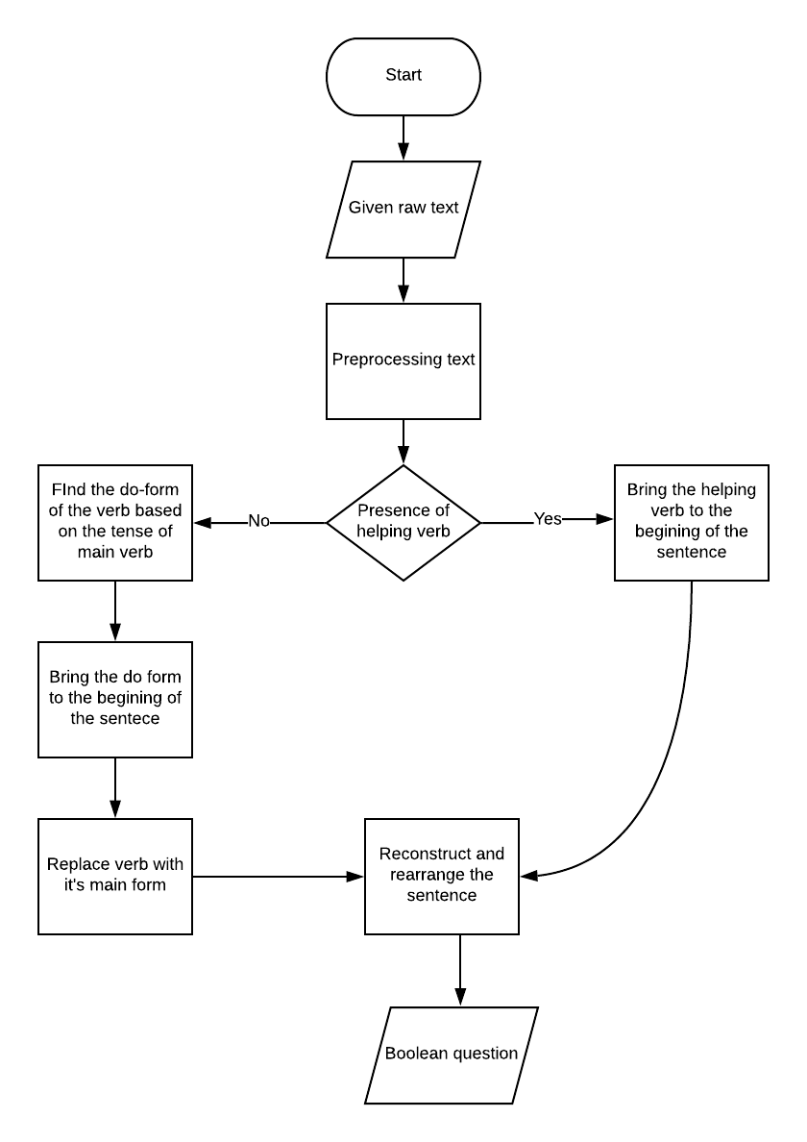
Flow for generating
Yes or No questions

Slide 12
Algorithm for generating ‘Wh’ questions
Identify the entity types in a sentence using NER models.
For each identified entity in extract ‘Wh’ word respective to entity type.
Wh word mapper must be constructed based on the position of entity in the sentence.
If the entity is subject then just replace the entity with it’s Wh word.
Else find relative pronoun of the respective entity type and add it to the yes or no question generated form the sentence.
Rearrange and reconstruct the sentence.

Slide 13
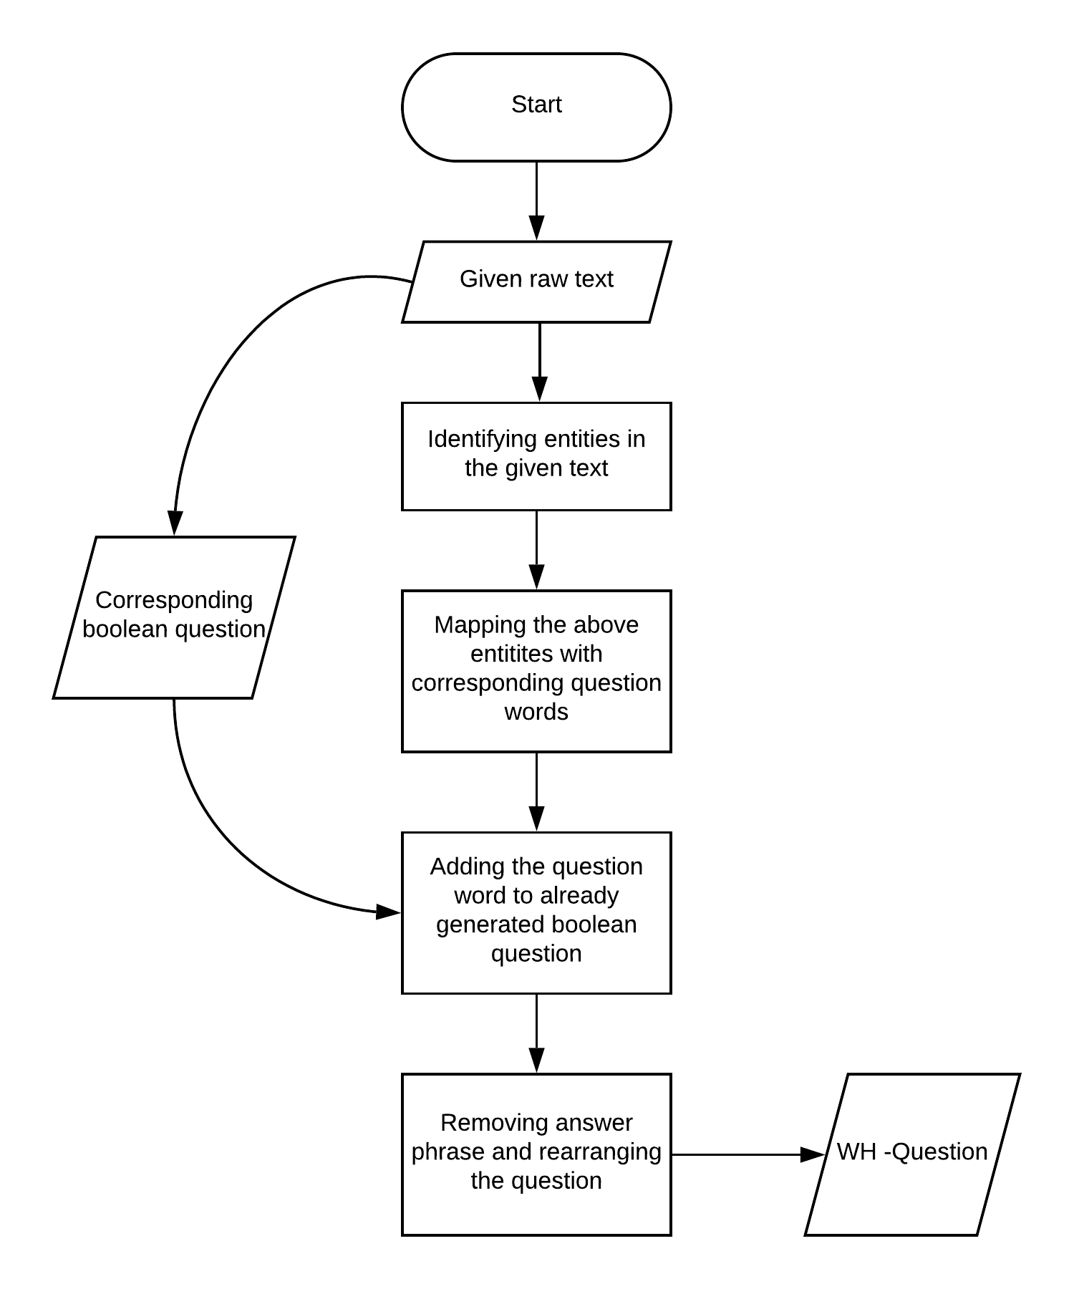
Flow for generating
‘Wh’ questions

Slide 14
NER (Named Entity Recognizer)
NER models identify the entity types, which are required in mapping their respective question words
Eg : Person: ‘Who or Whom’ , Location : ‘Where’ etc.
Some of the trained NER’s that are trained on general english :
Stanford-NER, Spacy etc.

Slide 15
About Cisco NER
As it is impossible to get all the entities of raw text, we proceed with the use case of Cisco documents.
We can train an existing NER with entities in Cisco documents.
In this use case we trained an NER which identify 18 entity types ,a few of them are : Product, Switches, Configuration, Capabilities etc.
These identified entities are now mapped with respective question words.

Slide 16
Phases a sentence undergoes:
Los Angeles became known as the "QotCC" for its role. --Unmovable.
Los Angeles became known as the "QotCC" for its role. --Answer phrase identification.
Los Angeles did become known as the "QotCC" for. --Decomposing main verb.
Did Los Angeles become known as the "QotCC" for. --Inverting subject.
What did Los Angeles become known as the "QotCC" for. --Removing answer phrase.
What did Los Angeles become known as the "QotCC" for? --Post processing.
Answer:...................................

Slide 17
Deficiency in generated question
Ungrammatical - not a valid english sentence.
Does not make sense (or) Irrelevant.
Wrong ‘Wh’ word selection.
Formatting - Capitalization, punctuation.

Slide 18
Question ranking
Model - Logistic regression
p(U | q, t) = 1 - p( A | q, t)
U - Unacceptance.
A- Acceptance.
q- For a given question ‘q’.
t- generated from text ‘t’.

Slide 19
Factors considered for acceptance
No of tokens.
Appropriate Wh words.
No of noun and prepositional phrases.
Presence of negation if needed.
Grammatically correctness.
Making sense.

Slide 20
Final distribution function
Conditional probability is considered as acceptance doesn’t depend on one factor.
p(a | q, t) = π 1-p( a_{i} | q, t)
1 <= i <= k ( k- no of factors of acceptance)

